Slide 1
Tracking HCV in City A: Demographic Disparities, and Seroconversion Trends 2022-2024
Carlos R. Alvarez, DrPH, CPH, MPH, a-IPC
Senior Epidemiologist
City A Department of Health (CADH)

Slide 2
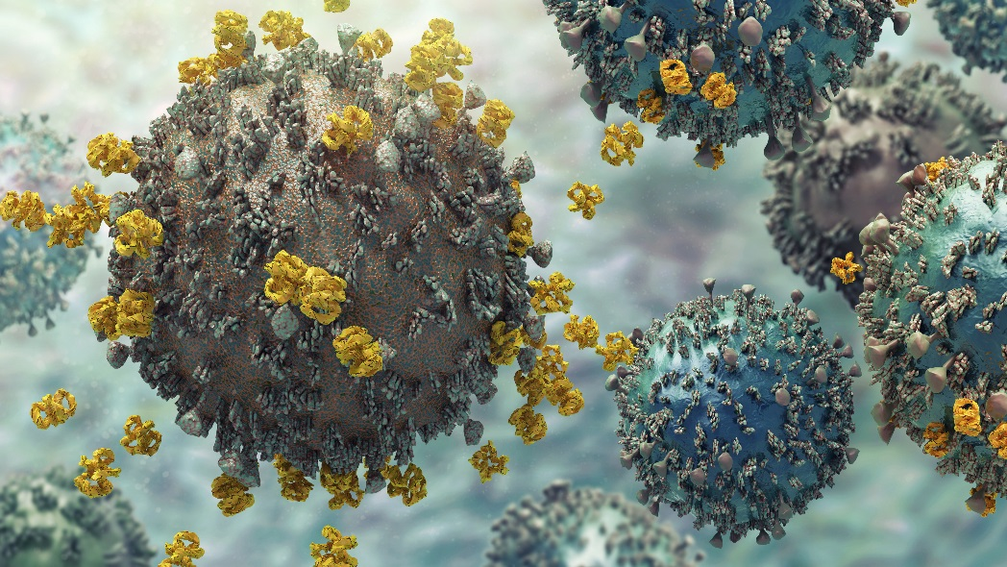
Hepatitis C Overview
Blood-Borne Virus
Previously known as non-A, non-B hepatitis
Incubation time of 14 to 180 days
Average 2-12 weeks
Causes inflammation of the liver leading to cirrhosis, liver failure and hepatocellular carcinoma (HCC)

Slide 3
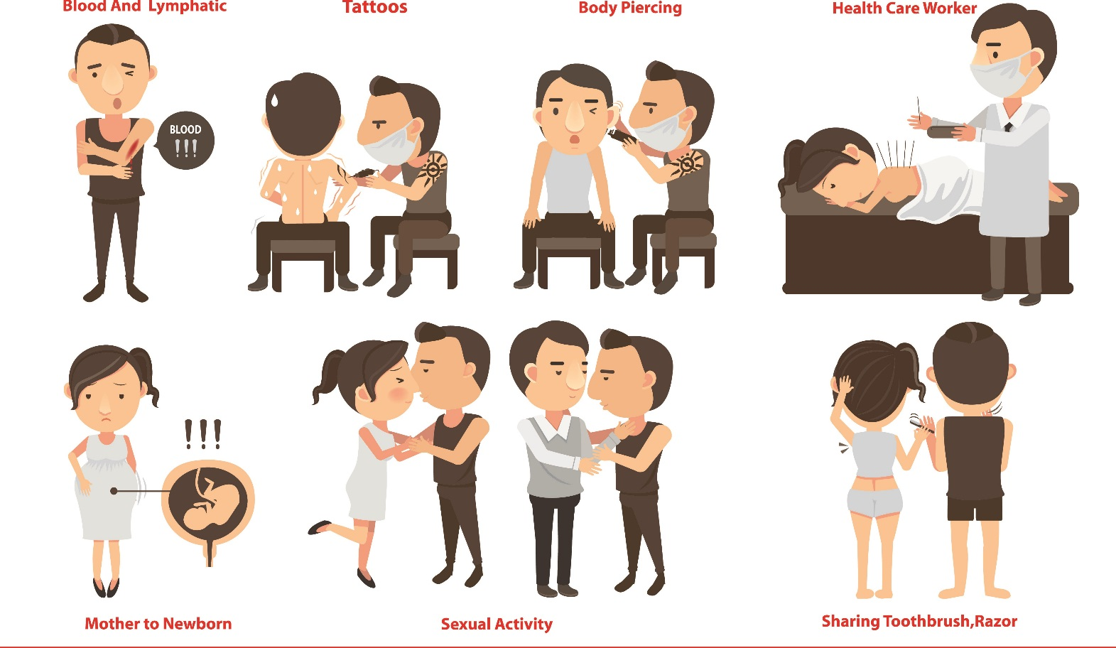
Hepatitis C Transmission

Slide 4
Hepatitis C Risk Factors
Born Between 1945 and 1965
HIV Positive
History of sexually transmitted diseases
Men who have sex with men (MSM)
Injection drug use (IDU)
Intranasal drug use (INDU)
Had sex for money/drugs
Prior/current incarceration
Employed in medical/dental field
Child born to hepatitis C + mother\
Received clotting factors, blood/blood products or organ transplant before 1992
Household Contact of confirmed or suspect to HCV case
Long term hemodialysis

Slide 5
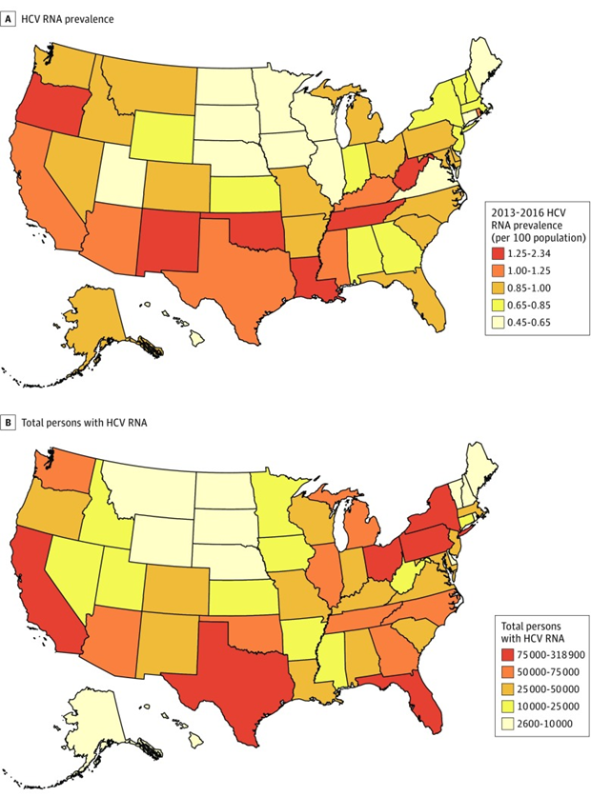
Hepatitis C in the United States
Most common blood-borne infection in the US
An estimated 2.3 million persons in the United States are living with hepatitis C
In 2013, HCV killed more people than all other infectious diseases reported to CDC
25% of those living with HIV in the US are co-infected with hepatitis C

Slide 6


City A’s HCV Surveillance Flow
Patient
Test
Disease Report
Paper Lab
ELR
Central Office or LRHD
Central Office or LRHD
National Electronic Disease Surveillance System (NEDSS)
CDC

Slide 7
Objectives
Assess HCV occurrence and rates in City A populations
Assess the conversion rate of HCV-negative individuals between 2022 and 2024

Slide 8
Methods
HCV laboratory data was extracted from the City A Electronic Disease Surveillance System (CAEDSS) for years 2022-2024
ELRs from reporting hospitals, laboratory facilities, clinics, etc.
HCV laboratory data was de-identified and prepared for analysis using SAS 9.4
HCV laboratory data was categorized into detected and not detected.
Detected = RNA detected, Positive for HCV antibodies, a numeric value for antibody or RNA, positive/reactive, a genotype specified
Not Detected = Negative, indeterminate

Slide 9
Methods
Performed a descriptive analysis to provide an overarching view of testing patterns, demographic distributions, and key epidemiologic trends across surveillance years
Conduct statistical analysis to examine associations between HCV detection rates and demographic factors such as age, race, and sex.
Determined the HCV seroconversion rate among individuals who previously tested negative, by longitudinally tracking results from 2022 to 2024.

Slide 10
Results
A total of 14,220 hepatitis laboratory records were reported to the CASS between 2022 and 2024
During initial review:
Some lab records did not reported a HCV result. It was determined that those records be deleted since the results were not relevant
Some lab records did not include Patient's date of Birth. It was determined that those records be deleted since verification is not possible.
After data cleaning was completed, a total of 14, 178 hepatitis laboratory records were included in the analysis
For reference, 99.6% of all reported HCV laboratory results were reported electronically.

Slide 11
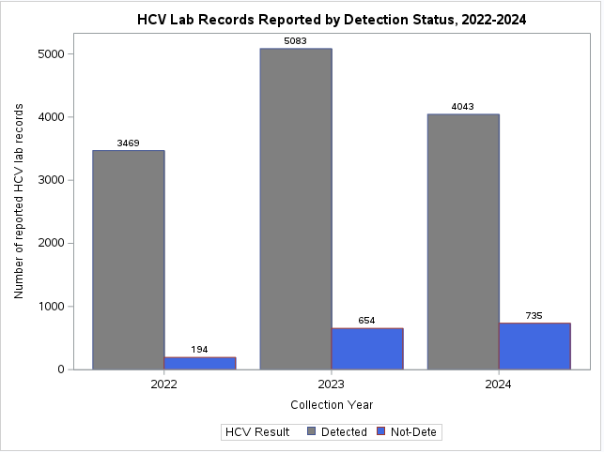
Results
Across all surveillance years, the majority of reported laboratory results were positive for HCV. This pattern is consistent with State A’s reporting guidelines, which do not mandate the submission of negative HCV test results to the health department.

Slide 12
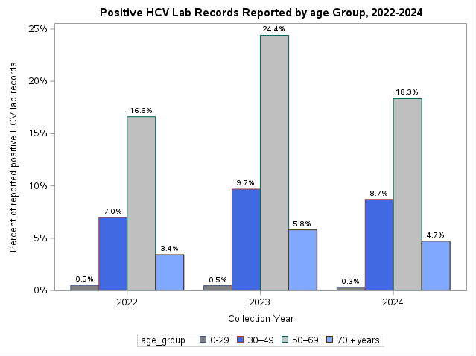
Results
The highest volume of reported HCV laboratory results was observed among individuals aged 50–69 years across all years, aligning with known prevalence patterns in the baby boomer cohort.
Individuals aged 30–49 years accounted for the second largest share of laboratory results for all years, suggesting evolving transmission dynamics or delayed diagnoses potentially linked to recent increases in injection drug use and acute HCV infections in younger populations

Slide 13
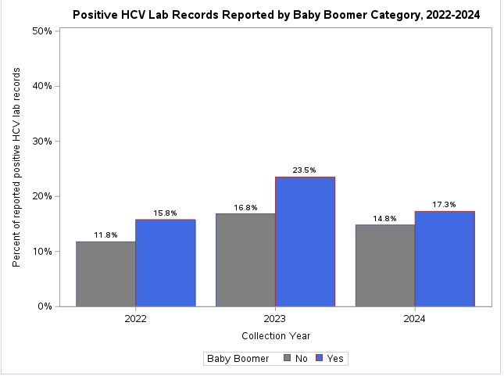
Results
Stratification by birth cohort confirms that individuals within the baby boomer group (ages 50–69) continue to represent the majority of reported HCV-positive laboratory results.
However, an increasing proportion of HCV-positive reports are emerging among non–baby boomer populations, indicating a shifting epidemiologic trend that may reflect evolving risk exposures in younger age groups

Slide 14
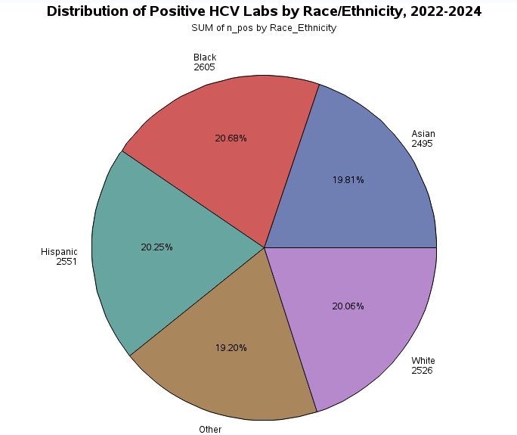
Results
The proportion of positive HCV lab results was relatively consistent across race and ethnicity groups (around 20%), which contrasts with broader epidemiologic expectations that often report higher burden among White populations.
This pattern may reflect the demographic diversity and unique population distribution of City A suggesting further in-depth analysis of HCV laboratory reporting

Slide 15
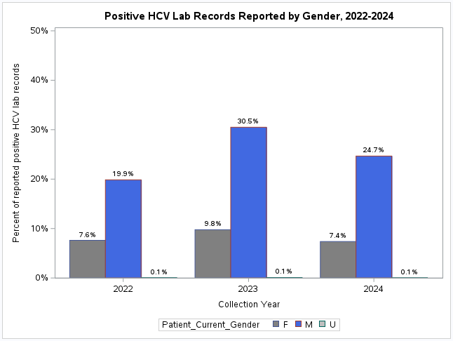
Results
Across all surveillance years, the majority of positive HCV laboratory results were reported among males. This is a pattern that appears consistent with national trends, where men have historically exhibited higher rates of HCV infection.

Slide 16
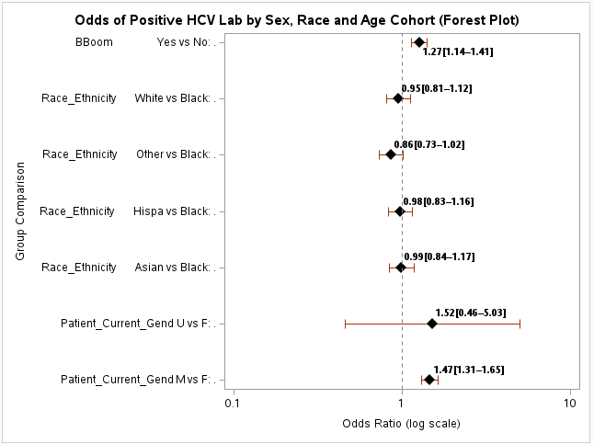
Results
Between 2022 to 2024, Baby boomers were 1.27 times more likely than non-baby boomers to have a positive HCV laboratory result.
Additionally, males were 1.47 times more likely than females to have a positive HCV laboratory result.
Other group comparisons were not statistically significant, indicating no relationship between a demographic group and having a positive HCV laboratory result

Slide 17
Results
Between 2022 to 2024, a total of 140 individuals seroconverted, with a average conversion time of approximately 120 days.
Males represented the majority (71.4%) of seroconversion cases, with an average seroconversion time of approximately 105 days.
Older adults aged 50–69 experienced the longest mean seroconversion time (150.4 days), suggesting delayed detection or follow-up in this age group.
Hispanic individuals had the longest seroconversion interval among racial/ethnic groups (138.5 days), which may warrant further investigation into testing access or follow-up practices.

Slide 18
Conclusions
Majority of HCV lab reports were positive, reflecting reporting practices that exclude negative results and emphasizing the importance of interpreting positivity rates within that context.
Males and baby boomers had significantly higher odds of a positive HCV result, while younger adults (30–49) showed rising positivity, suggesting shifting transmission trends.
Older adults (50–69), males, and Hispanic individuals experienced longer HCV seroconversion times, highlighting potential gaps in timely testing or follow-up that have implications for targeted surveillance and early intervention strategies.
Surveillance Implication: These findings highlight the need to improve data quality in ELR systems and expand targeted HCV screening efforts to include younger adults, not just legacy high-risk groups.

